Slide 1
Employee Data Analysis using Excel
STUDENT NAME:R.MUTHUPRIYA
REGISTER NO:312204191
DEPARTMENT:B.COM(GENERAL)
COLLEGE:C.S.I EWART WOMEN’S CHRISTIAN COLLEGE.
NM ID Username:993D5B896984D9380464E4235C6D

Slide 2
PROJECT TITLE
Employee Performance Analysis using Excel

Slide 3


AGENDA
Problem Statement
Project Overview
End Users
Our Solution and Proposition
Dataset Description
Modelling Approach
Results and Discussion
Conclusion
3/21/2024 Annual Review

Slide 4

PROBLEM STATEMENT
Basic Excel functions may not fully support advanced performance analysis.
Need for complex formulas or additional tools for in-depth analysis.

Slide 5

PROJECT OVERVIEW
Implement charts and graphs to visualize performance trends.
.

Slide 6

WHO ARE THE END USERS?
HR professionals
Employees
Managers and supervisors.
IT Sector
Different organisation

Slide 7

OUR SOLUTION AND ITS VALUE PROPOSITION
Conditional formating-missing
Filter-remove
Formula-performance
Pivot summary
Graph –Data visualization
Value proposition:
Enhanced decision making
Increased efficiency.

Slide 8
Dataset Description
Employee dataset-kagle
First Name
Last Name
Business units
Gender-Male,female
Performance level
Rating
Employee timing –full time (or) contract

Slide 9

THE “WOW” IN OUR SOLUTION
Performance level formula =IFS (Z2>=5,”VERY high”, Z2>=4,”High”,Z2>=3, “Med”,TRUE,”Low”)
,
3/21/2024 Annual Review
9

Slide 10
MODELLING
Visualization
Formulas
Data collection
10

Slide 11
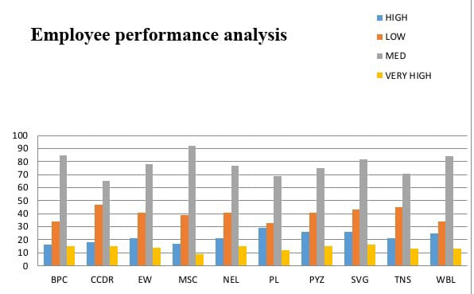
RESULTS
11

Slide 12
conclusion
The conclusion section of an employee performance analysis using Excel should summarize the key insights, evaluate the effectiveness of the analysis, and provide a clear path forward.

